Slide 1
Use, User, Usability

Slide 2
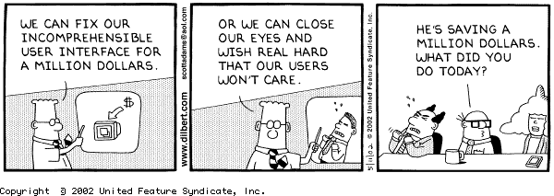

Slide 3
What is User-Centered Design?
An approach to UI development and system development.
Focuses on understanding:
  Users, and
  Their goals and tasks, and
  The environment (physical, organizational, social)
Pay attention to these throughout development

Slide 4
ISO on User-centered Design
ISO 13407 describes human-centered design processes for interactive systems
Principles of human-centered design:
  Active involvement of users
  Appropriate allocation of function between user and system
  Iteration of design solutions
  Multidisciplinary design teams

Slide 5
ISO on User-centered Design (2)
Essential activities in human-centered design:
  Understand and specify the context of use
  Specify the user and organizational requirements
  Produce design solutions (prototypes)
  Evaluate designs with users against requirements

Slide 6
What is a user-centered approach?
User-centered approach is based on:
  Early focus on users and tasks: directly studying cognitive, behavioral, anthropomorphic & attitudinal characteristics
  Empirical measurement: users’ reactions and performance to scenarios, manuals, simulations & prototypes are observed, recorded and analysed
  Iterative design: when problems are found in user testing, fix them and carry out more tests

Slide 7
Four basic activities
There are four basic activities in Interaction Design:
  1. Identifying needs and establishing requirements
  2. Developing alternative designs
  3. Building interactive versions of the designs
  4. Evaluating designs

Slide 8
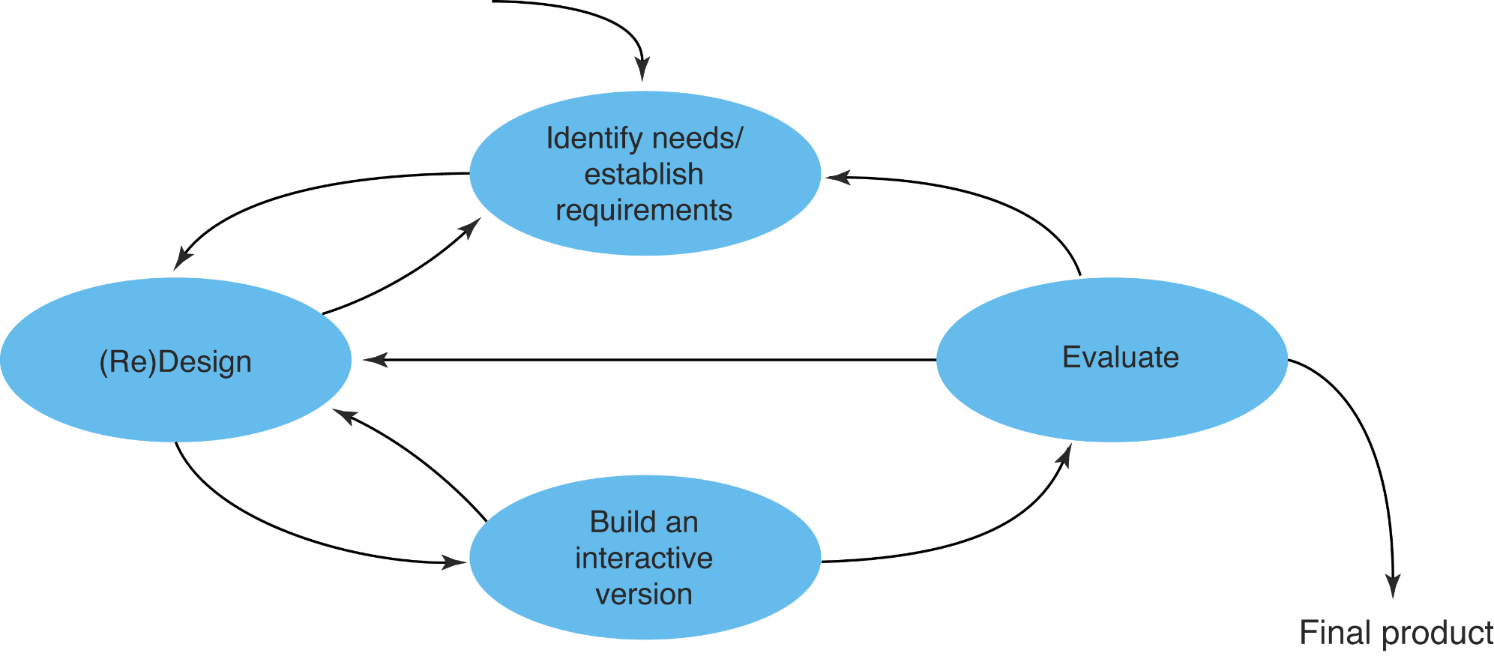
A simple interaction design model
Exemplifies a user-centered design approach

Slide 9
Some practical issues
Who are the users?
What are ‘needs’?

Slide 10
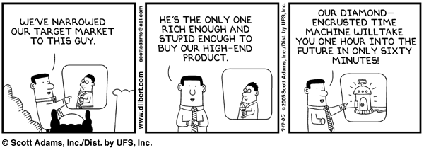
Target users

Slide 11
Who are the users/stakeholders?
Not as obvious as you think:
  those who interact directly with the product
  those who manage direct users
  those who receive output from the product
  those who make the purchasing decision
  those who use competitor’s products
Three categories of user (Eason, 1987):
  primary: frequent hands-on
  secondary: occasional or via someone else
  tertiary: affected by its introduction, or will influence its purchase

Slide 12
What are the users’ capabilities?
Individual differences:
  size of hands may affect the size and positioning of input buttons
  motor abilities may affect the suitability of certain input and output devices
  height if designing a physical kiosk
  strength - a child’s toy requires little strength to operate, but greater strength to change batteries
  disabilities (e.g. sight, hearing, dexterity)
    abilities also vary according to context

Slide 13
What are ‘needs’?
Users rarely know what is possible
Users can’t tell you what they ‘need’ to help them achieve their goals
Instead, look at existing tasks:
  their context
  what information do they require?
  who collaborates to achieve the task?
  why is the task achieved the way it is?
Envisioned tasks:
  can be rooted in existing behaviour
  can be described as future scenarios

Slide 14
Brief overview of common methods to gather user data
    Interviews
    Questionnaires
    Observation
    Choosing and combining techniques

Slide 15
Interviews
Unstructured - are not directed by a script. Rich but not replicable.
Structured - are tightly scripted, a questionnaire delivered verbally. Replicable but may lack richness.
Semi-structured - guided by a script but interesting issues can be explored in more depth. Can provide a good balance between richness and replicability.

Slide 16
Contextual Inquiry
An approach to ethnographic study. Often conducted as an apprenticeship where user is expert, designer is apprentice
A form of interview, but
  at users’ workplace (workstation)
  2 to 3 hours long
Four main principles:
  Context: see workplace & what happens
  Partnership: user and developer collaborate
  Interpretation: observations interpreted by user and developer together
  Focus: project focus to understand what to look for

Slide 17
Questionnaires
Questions can be closed or open
Closed questions are easier to analyze, and may be done by computer
Can be administered to large populations
Paper, email and the web used for dissemination
Sampling can be a problem when the size of a population is unknown as is common online

Slide 18
Questionnaire design
The impact of a question can be influenced by question order.
Do you need different versions of the questionnaire for different populations?
Provide clear instructions on how to complete the questionnaire.
Strike a balance between using white space and keeping the questionnaire compact.
Decide on whether phrases will all be positive, all negative or mixed.

Slide 19
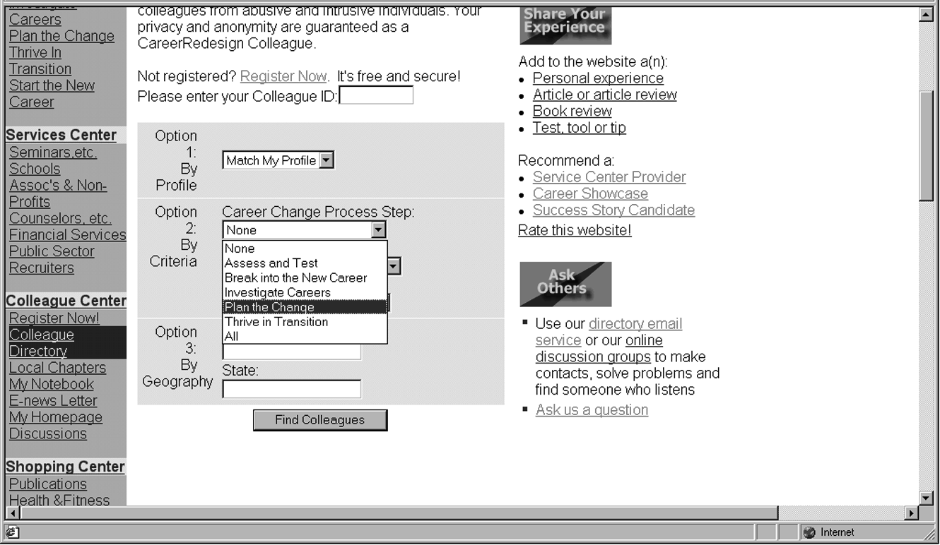
Advantages of online questionnaires
Responses are usually received quickly
No copying and postage costs
Data can be collected in database for analysis
Time required for data analysis is reduced
Errors can be corrected easily

Slide 20
Problems with online questionnaires
Sampling is problematic if population size is unknown
Preventing individuals from responding more than once
Individuals have also been known to change questions in email questionnaires

Slide 21

Observation
Direct observation in the field
  Structuring frameworks
  Degree of participation (insider or outsider)
  Ethnography
Direct observation in controlled environments
Indirect observation: tracking users’ activities
  Diaries
  Interaction logging

Slide 22
Structuring frameworks to guide observation
- The person. Who?
- The place. Where?
- The thing. What?
The Goetz and LeCompte (1984) framework:
- Who is present?
- What is their role?
- What is happening?
- When does the activity occur?
- Where is it happening?
- Why is it happening?
- How is the activity organized?

Slide 23
Choosing and combining techniques
Depends on
  The focus of the study
  The participants involved
  The nature of the technique
  The resources available

Slide 24


